Slide 1

Saturday
5K

Slide 2
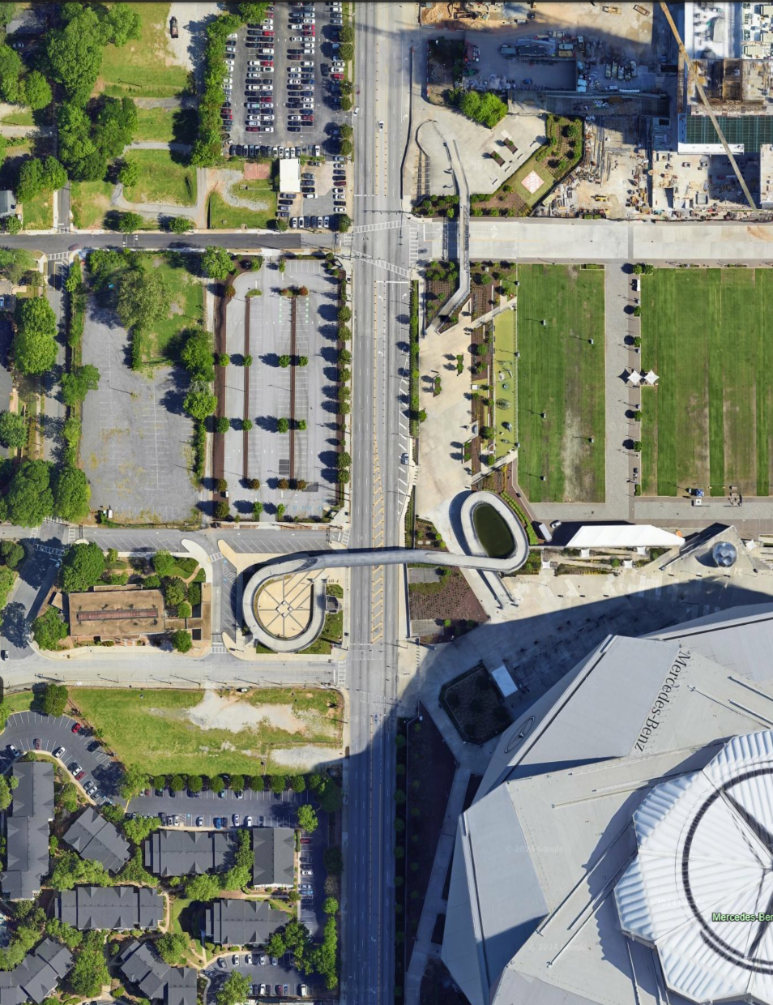
PUBLIX ATLANTA 5K
Walk to Start Line
Finish
HOME DEPOT BACKYARD

Slide 3
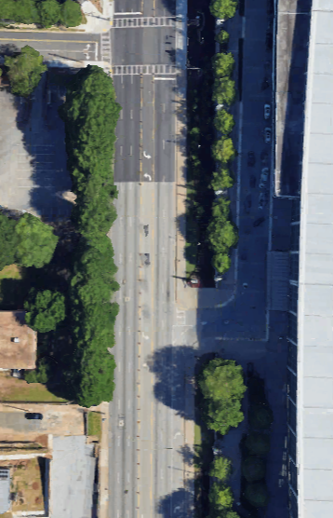
PUBLIX ATLANTA 5K
START LINE AREA
2026 Saturday Morning
4:00 – 7:55 AM
Thurmond St NW
Media
MEDIA BOX
Start Line
A
B
Georgia World Congress Center
Northside Dr
C
Walking route from HDBY
D

Slide 4
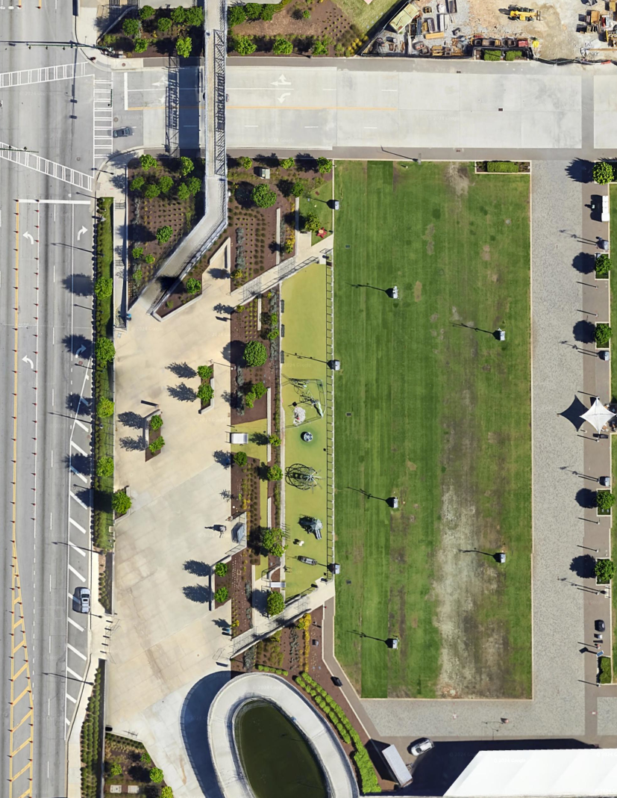
PUBLIX ATLANTA 5K
FINISH LINE AREA
2026 Saturday Morning
7:50 – 10:15 AM
Winners
Finish
MEDIA/ PHOTO BOX
Notes:
All winners finish runner left

