Slide 1
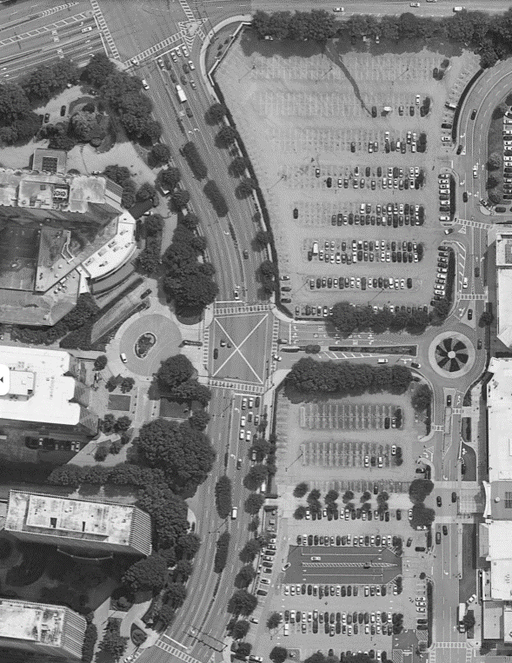




Start Line – Media
Start
Area
EXPO TENTS
CLOSED TO PUBLIC
Start
Line
BOH
A
S
B
Media Credentialed area
Elites
MEDIA PARKING
(SHARED BY STAFF & BROADCAST TEAM)
Notes:
Add credential boards

